Slide 1

DevOps Migration Strategy: From Azure DevOps to GitLab with DevXcelerate
Transforming legacy pipelines into modern, scalable workflows with AI-powered automation

Slide 2

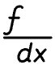
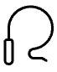

Why Migrate from Azure DevOps to GitLab?
Unified DevSecOps Platform
Open-Core Flexibility
Leverage GitLab's integrated CI/CD, security scanning, and comprehensive DevOps toolchain in one cohesive environment
Streamline workflows with GitLab's extensive plugin ecosystem and open-source adaptability for custom requirements
Enhanced Automation
Address evolving business needs with advanced pipeline automation, improved collaboration, and modern DevOps practices

Slide 3


Understanding the Existing Azure DevOps Pipelines Landscape
Build Pipelines
Release Pipelines
Sophisticated integration with SonarQube for code quality analysis and NexusIQ for security vulnerability scanning
Configuration-based deployment workflows with environment-specific settings and approval gates
Complex ecosystem featuring custom tasks, bespoke plugins, and intricate pipeline dependencies tailored to organisational requirements

Slide 4

Migration Challenges: Beyond Simple Pipeline Conversion
01
YAML Translation Complexity
Converting Azure DevOps YAML and classic pipelines into GitLab CI syntax whilst preserving functionality and logic
02
Custom Components Migration
Re-implementing bespoke tasks and plugins within GitLab's runner architecture and job execution framework
03
Security Integration
Maintaining seamless SonarQube and NexusIQ security scans without disrupting existing quality gates
04
Configuration Preservation
Ensuring release pipeline configurations remain robust, environment-aware, and deployment-ready

Slide 5




Introducing DevXcelerate: AI-Powered Pipeline Migration & Generation
Intelligent Analysis
Gen AI-enabled solution that comprehensively analyses existing Azure DevOps pipelines, custom tasks, and plugin dependencies
Automated Conversion
Generates optimised GitLab CI pipelines with integrated security scanning and artifact management capabilities
Accelerated Delivery
Dramatically reduces manual effort, accelerates migration timelines, and minimises human error risks

Slide 6
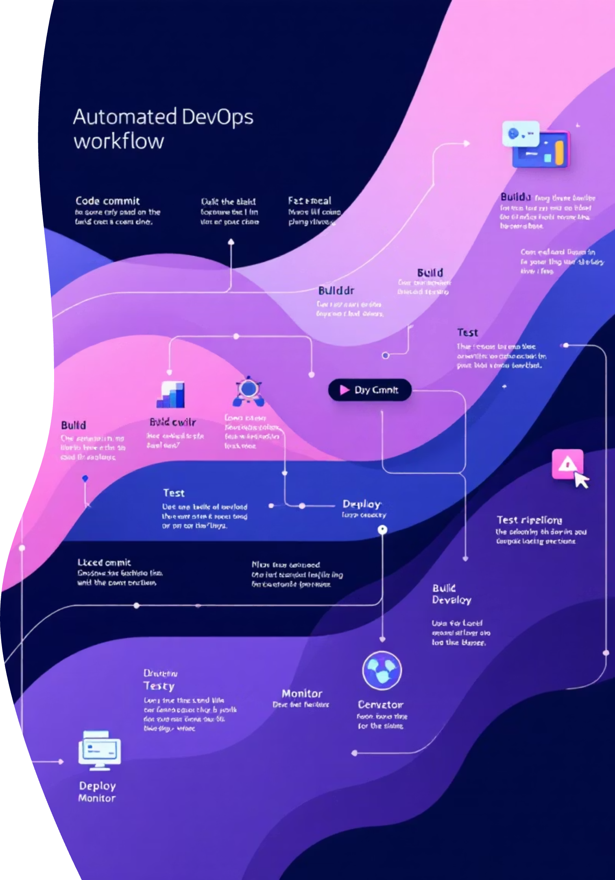



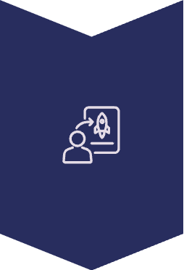
How DevXcelerate Works: Step-by-Step Migration Flow
Pipeline Inventory & Analysis
Comprehensive scanning of Azure DevOps pipelines, custom scripts, integrations, and dependencies
AI-Driven Conversion
Intelligent translation of build and release pipelines into GitLab CI YAML with preserved custom logic
Validation & Testing
Automated test runs verifying pipeline functionality, security scans, and deployment processes
Deployment & Monitoring
Pipeline deployment in GitLab with continuous feedback loops for performance optimisation

